Slide 1
Bitcoin price prediction

Slide 2
introduction
Bitcoin is the most popular and valuable cryptocurrency and it is a medium of exchange which is digital in nature ,in this we are predicting bitcoin price prediction using LSTM .
Now we can more about LSTM and RNN

Slide 3
DEEP LEARNING
Deep learning is an artificial intelligence (AI) function that imitates the workings of the human brain in processing data and creating patterns for use in decision making
Deep learning is a subset of machine learning, which essentially a neural network with three or more layers
Deep learning attempts to mimic the human brain albeit far from matching its ability-enabling systems to cluster data and make predictions with incredible accuracy

Slide 4
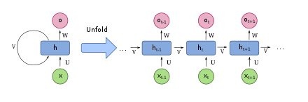
What is RNN?
Recurrent neural networks (RNNs) are a class of neural network that are helpful in modeling sequence data.
RNN can get output from the previous step and can use as input to the current steps.
RNN can use information in arbitrarily long sequences, but practically they are limited to look back only a few steps.
This Photo by Unknown Author is licensed under CC BY-SA

Slide 5
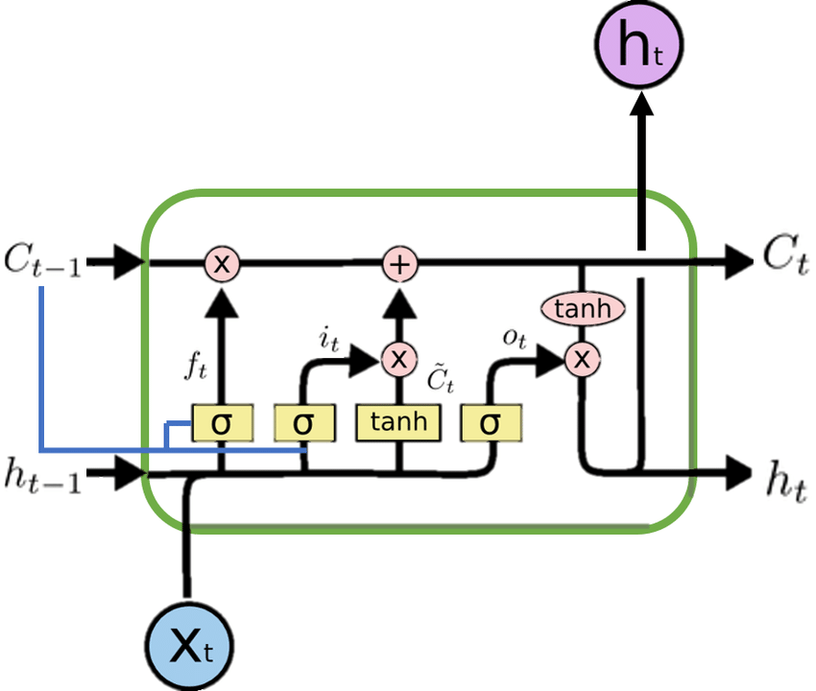
Long Short-Term Memory(LSTM)
LSTM networks are an extension of RNN that extend the memory. LSTM are used as the building blocks for the layers of a RNN.
LSTM is the memory cell in which it stores the information
The LSTM can read, write and delete information from its memory.

Slide 6
YAHOO! Finance price dataset
Yahoo! Finance is a media property that is a part of the yahoo! Network. It provides financial news, data and commentary including stock quotes, press releases, financial reports ,and orginal contents. It also offers some online tools for personal finance management.
We have used 9 years of price values from (2014-2022) for the prediction

Slide 7
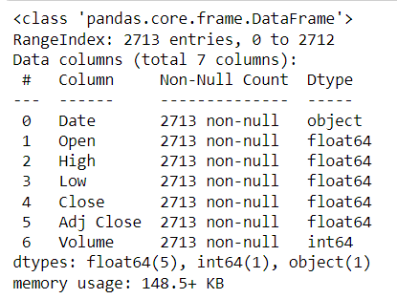
DATASET
The dataset used in this project of yahoo finance price contains 7 data columns, and we have 2713 rows of data available.
the missing value analysis is averted because the data set have no null values
Date – on which date
Open – open price of the day
High - high price of the day

Slide 8
Problem statement
To accurately predict the future close value of the bitcoin price for some period of time in future
In the prediction we have predicted the price value for next 30 days with past 15 days
To use different deep learning models in the python and compare them

Slide 9
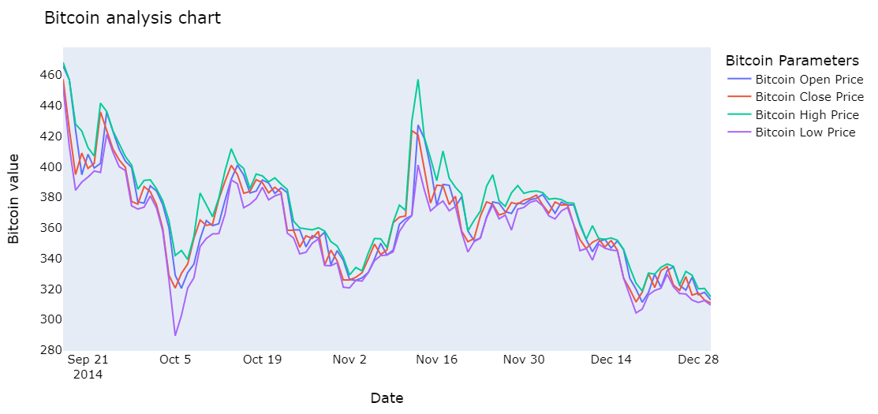
Exploratory data analysis
This graph shows the month wise open and close price and high and low price analysis
This chart is only for the year 2014 and as like the same we have analysied for every year upto 2022
in this year data starts from sept so we have other months upto sept will be Nan

Slide 10
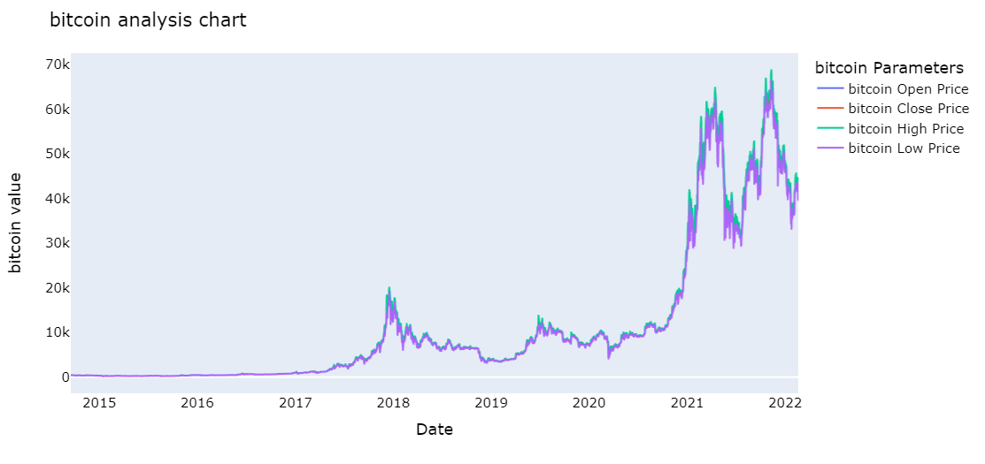
Overall data analysis
This is the chart of over-all data analysis of the bitcoin price from 2014- 2022
As we can see blue color line indicates open price and orange line for close price
Green line for high bitcoin price and violet for low price

Slide 11
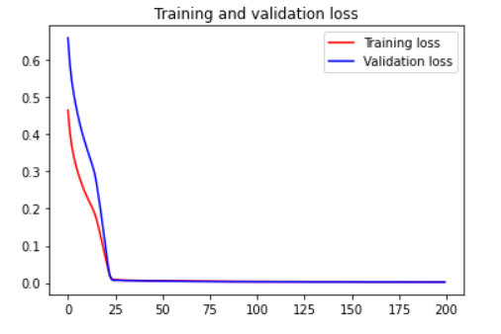
Training and validation loss
we can see the training and validation loss from the below

Slide 12
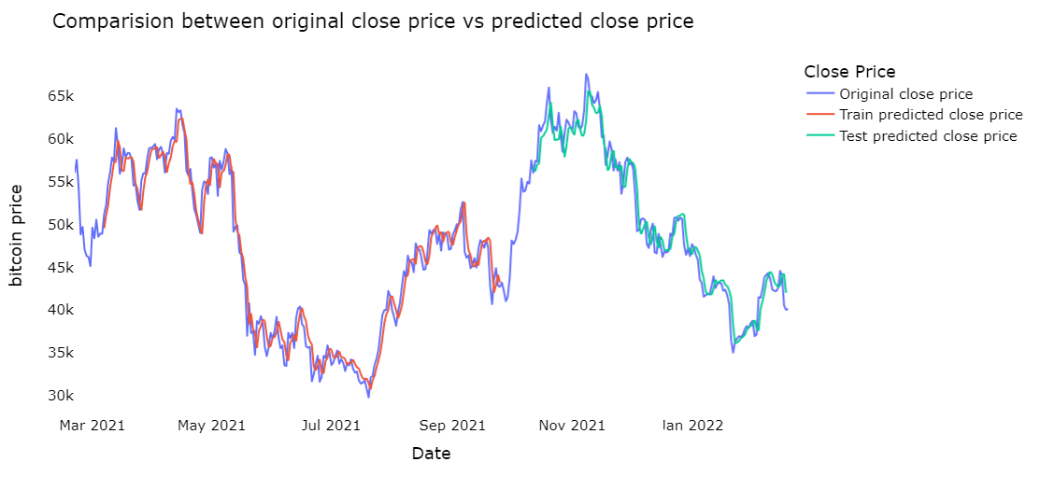
comparison
This is the camparison between original close price and predicted close price
As we can see blue color denotes original close price
Red color line is the train predict close price and green line as test predict close price

Slide 13
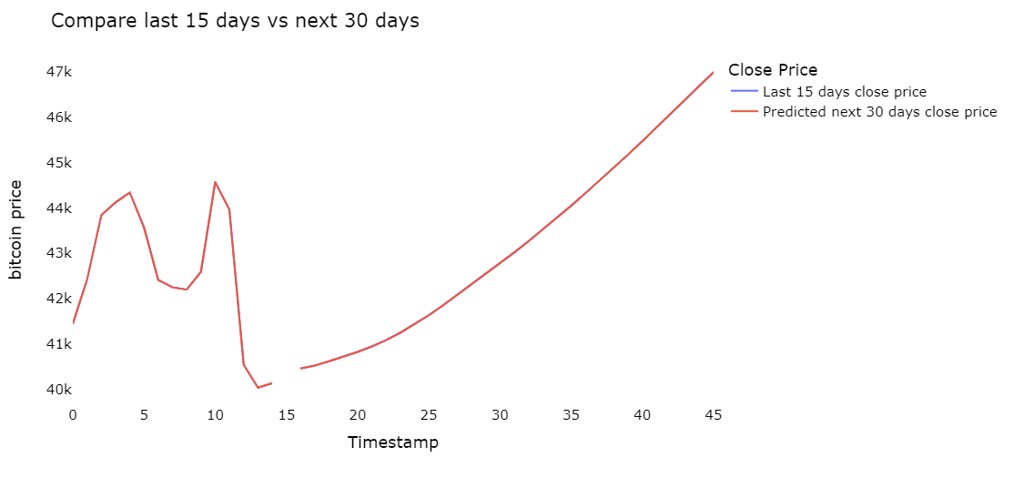
Comparing the past values
In this graph we have compared the bitcoin price of past 15 days and with next 30 days
As we can see blue line indicates the last 15 days and the red line indicates the next 30 days
In this we can see price of the bitcoins are are increasing

Slide 14
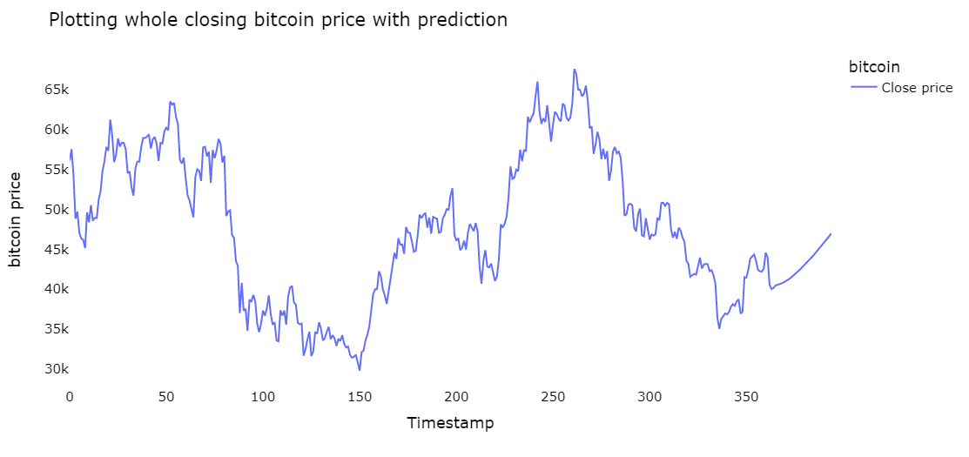
LSTM RESULT
This is the predicted whole closing bitcoin price model for the next next 30 days

Slide 15
conclusion
We can see the prediction , analysis and visualization of bitcoin price through applying deep learning algorithms
We have applied some models for prediction of close price of bitcoin price
Evaluation of matrices RMSE of 17.
Variance regression score of 96%
R square score of 96%

Slide 16
Thank you

